Slide 1
Great Theorem: The Divergence of the Harmonic Series
Bernoulli
Journey Through Genius Pp 196

Slide 2
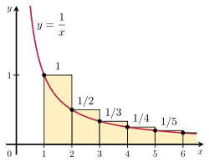
Notes on the theorem:
This proof was concocted by Johann but appears in Jakobs Tractatus de seriebus infinitis, but Jakob gave proper credit to his brother
Johann had to show the harmonic series diverges to infinity, and he rested his argument on the argument of Leibniz with his convergent series we examined earlier
Peculiar that the “well-behaved” convergent series sheds light on the bizarre harmonic series

Slide 3
Let’s now examine Johann’s argument for this great theorem.

Slide 4
Introduce the series A

Slide 5
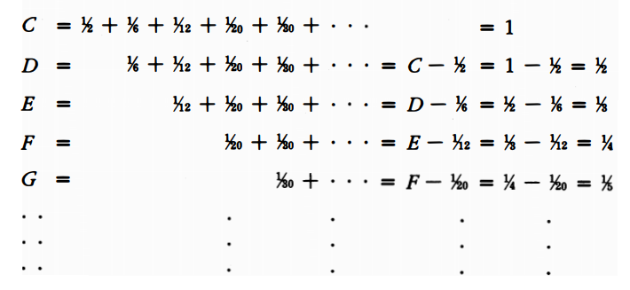
Where C is the series Leibniz had solved, Johann constructed,

Slide 6
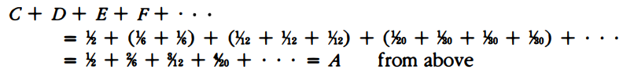
He then summed up the two leftmost columns to get …
Then, summed up the leftmost and rightmost columns to get…

Slide 7
Johann then concluded that because the sum of the series equals both A and 1+A, then he concluded that A = 1 + A, he put it “the whole equals the part”.
No finite quantity could be equal to one more than itself, thus he concluded that A must be an infinite quantity. Since 1+A was the sum of the harmonic series, than his argument was finished.

Slide 8
Some analysis and remarks
His method of showing divergence differs greatly from today’s method
Today one would take any large quantity N (no matter how large) and show the series exceeds N, then since the series surpasses any whole number, it must diverge to infinity
Jakob observed, “The sum of an infinite series whose final term vanishes perhaps is finite, perhaps infinite.”
Although this wording makes a modern student cringe using the phrase “final term” of a series, but Jakob is commenting on the earlier conjecture, even if the individual terms of the series approach zero, that does not guarantee the series itself converges.

Slide 9
Jakob, perhaps due to the unexpectedness of this result pens,
As the finite encloses an infinite series
And in the unlimited limits appear
So the soul of immensity dwells minutia
And in narrowest limits no limits inhere
What joy to discern the minute to infinity!
The vast to perceive in the small, what divinity!

